Slide 1
Taming the JavaScript Dragon with TypeScript
Dustin Ewers
Consultant @ Centare
Website: www.dustinewers.com
LinkedIn: www.linkedin.com/in/dustinewers
Demo Code: https://github.com/DustinEwers/typescript-demos

Slide 2
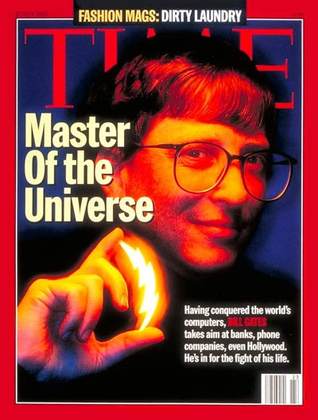
1995
Notes:
1995 had lots of major cultural achievements
Gates = sith lord

Slide 3

1995
Notes:
First computer rendered movie. Took a room of computers, but now could be done on my watch.

Slide 4

1995
Gangster’s Paradise
Notes:
… and Gangsters Paradise
Jagged Little Pill also came out that year.

Slide 5


JavaScript: A History Lesson
Notes:
Brendan Eich
10 days
Standardized in 1996
Purpose: Add dynamic elements to web pages

Slide 6
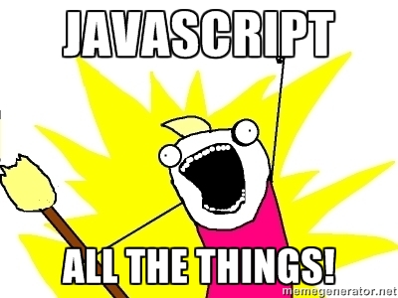
Microcontrollers: Johnny-Five
Servers: Node.js
Command line tools: npm, gulp, etc...
Mobile Apps: Cordova, Ionic
Desktop applications: Electron
VR: Renderloop, Three.js

Slide 7
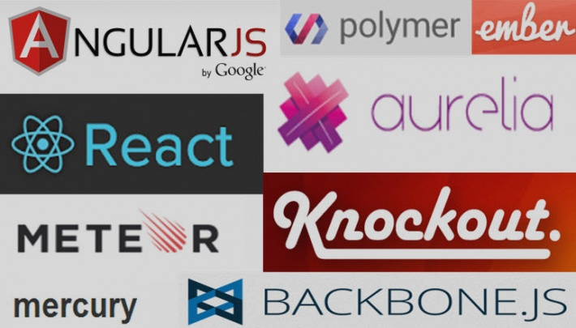

Slide 8


Slide 9
that’s cool, but…
Notes:
… but there’s a problem
JavaScript isn’t made for the massive apps we use it on

Slide 10


Slide 11
JavaScript: The Lousy Parts
Weird/Unfamiliar Inheritance
No Modules
Dynamically Typed
Horrendous Scoping

Slide 12
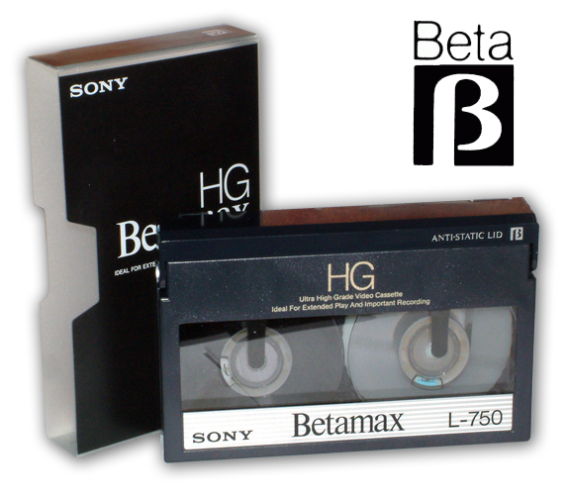
JavaScript == VHS
Notes:
JavaScript is the VHS of the web. Popular, but not that good.

Slide 13
So why are we using JavaScript?
Runs everywhere
Smart People
Amazing Frameworks

Slide 14
Escaping The Fail
Use new JS Today
Use another language

Slide 15
ECMAScript 2015 / ES6
Classes, modules, and scoped variables
Tasty Syntactic Sugar like arrow function and string interpolation
Transpilation (Babel, Traceur)

Slide 16
JavaScript as the New Assembler
There are over 200 different JavaScript compilers.
Notes:
https://github.com/jashkenas/coffeescript/wiki/List-of-languages-that-compile-to-JS
Don’t forget to mention COBOL Script
Popular ones include CoffeeScript and Dart
Other compilers exist for C#, Java, Ruby, etc…

Slide 17
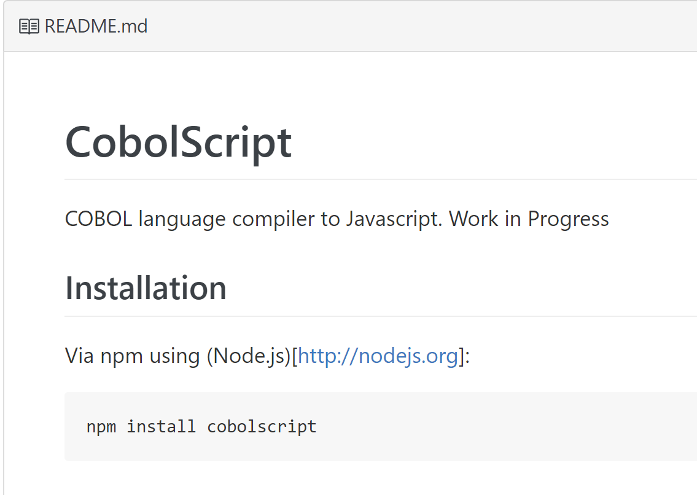
Notes:
https://github.com/ajlopez/CobolScript

Slide 18
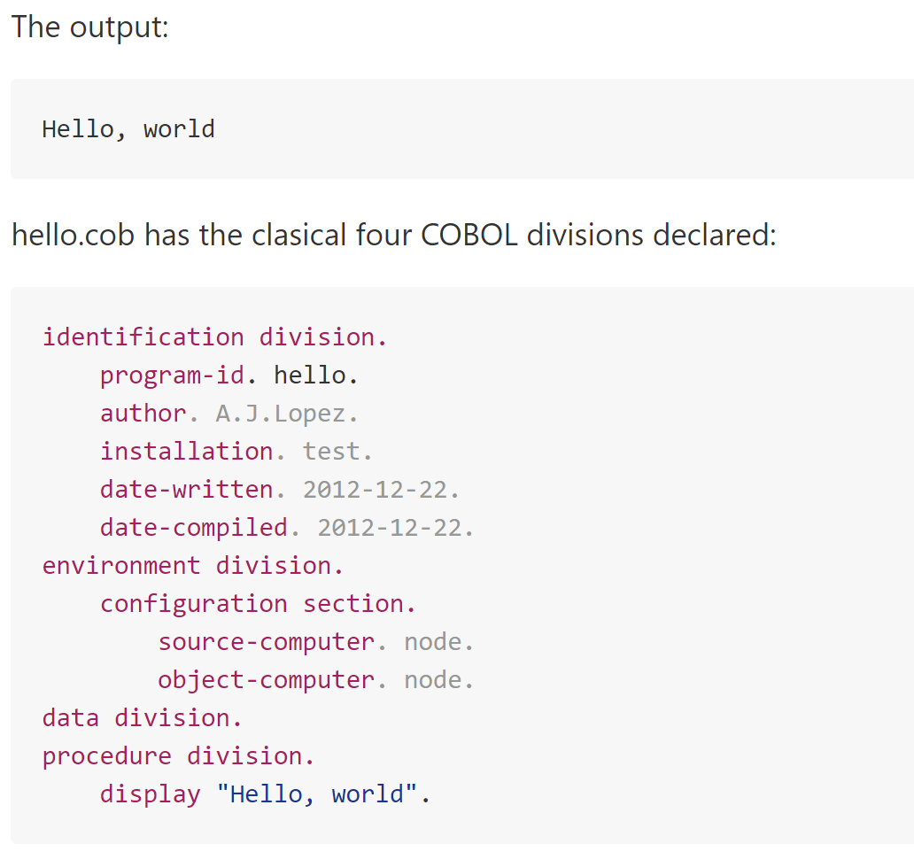

Slide 19
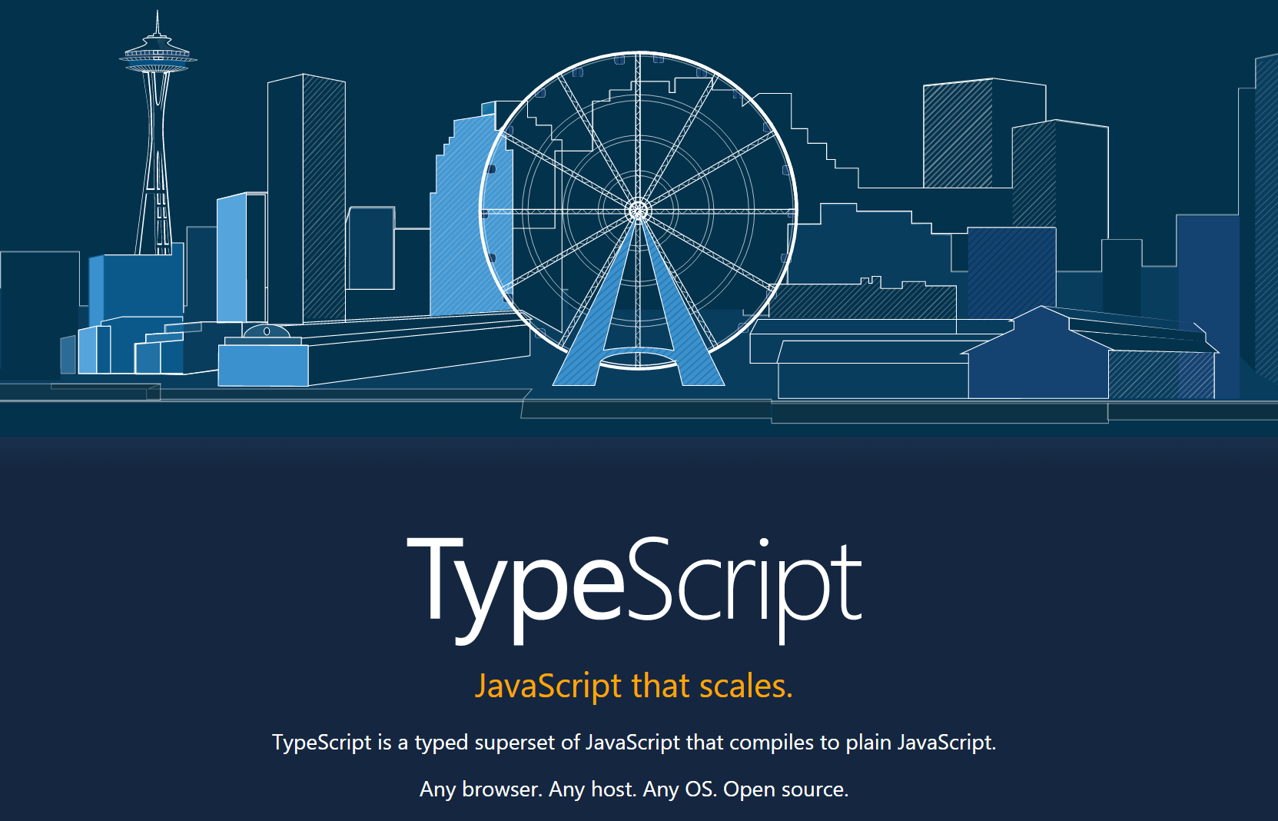
Notes:
https://www.typescriptlang.org/
Kinda in the middle
Superset of JS
ES6/ES7 Features
Optional Static Typing

Slide 20
TypeScript: A brief history
Invented by Microsoft
Released in 2012 (after two years, not 10 days)
Up to Typescript 2.0

Slide 21
Why TypeScript?
It mitigates JavaScript’s primary weakness

Slide 22

Why TypeScript? - Static Typing
Notes:
This allows you to have high quality refactoring tools and compile time error checking.

Slide 23
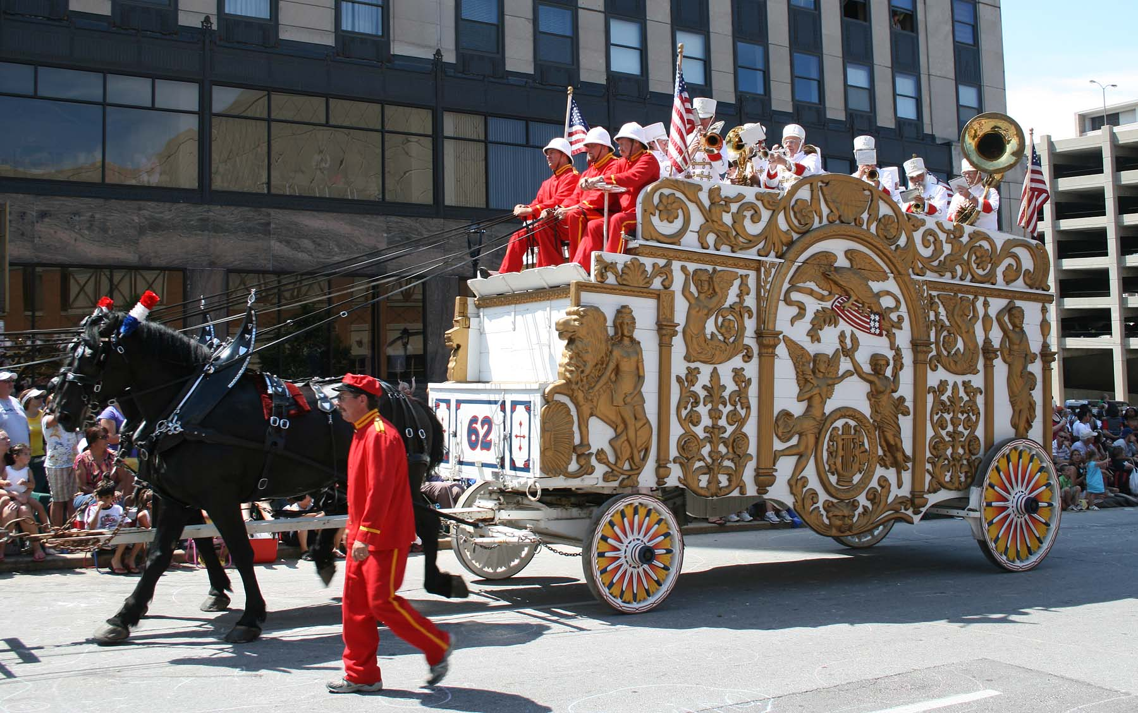
Why TypeScript? – Adoption
15,000+ on GitHub
Over 2 million NPM Downloads
Used by: Microsoft, Angular.js,
Ionic, Telerik, JetBrains,
and many others
Notes:
Angular 2 is written in Typescript
Also, the Azure Dashboard

Slide 24
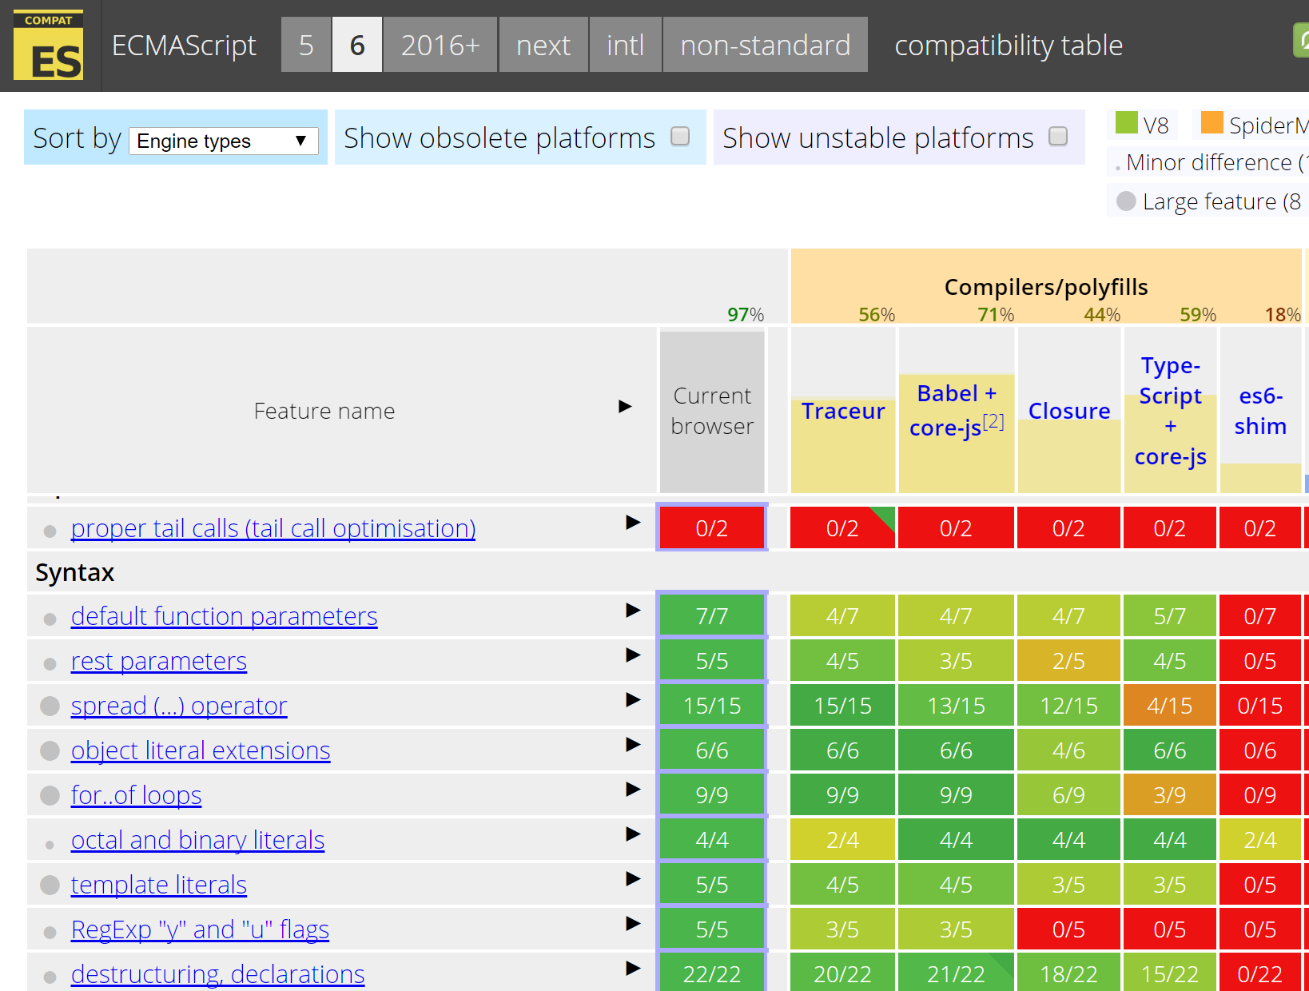
Notes:
http://kangax.github.io/compat-table/es6/

Slide 25
How do I get Started?
TypeScript Playground
TypeScript Handbook
TypeScript Deep Dive

Slide 26
Editors
alm.tools
Atom
CATS
Eclipse
Emacs
NetBeans
Sublime Text
Vim
Visual Studio
Visual Studio Code
WebStorm

Slide 27

Tooling – Visual Studio
Notes:
Rename the files. Visual Studio will compile for you

Slide 28
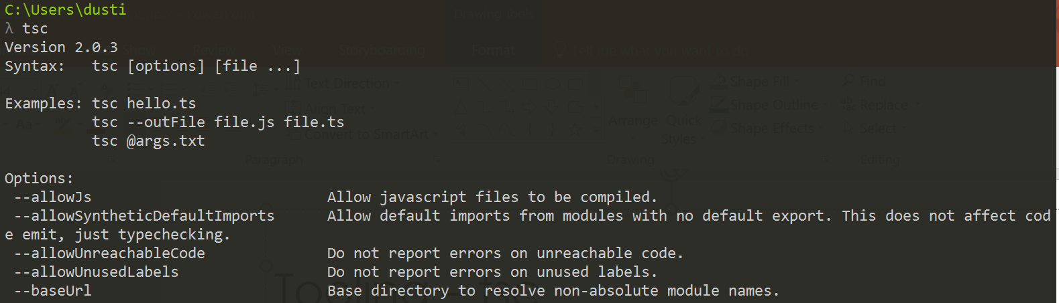
Tooling – tsc

Slide 29
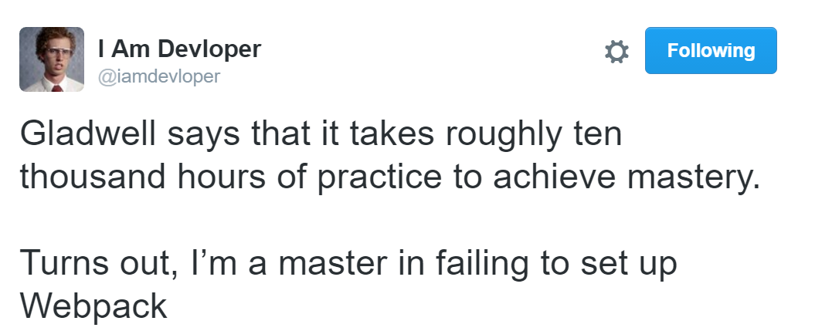
Tooling – Gulp/Webpack/Etc…
Visual Studio
Command Line

Slide 30
Setup Time Savers
Steve Sanderson’s Angular 2/TypeScript/Webpack template
ASP.NET Core
ASP.NET 4
Gulp / NPM

Slide 31
Demos
Notes:
Demo list:
One Page Guide
Basic features
Traditional tooling, tsd files
Ninjas Quest:
Tsconfig,
Ng2, components, models, etc…
tslint,
webpack,
modules,
Ng2 integration,

Slide 32

Major Takeaway
If you’re doing any client side work in .NET, TypeScript is the logical choice.
Website: www.dustinewers.com
LinkedIn: www.linkedin.com/in/dustinewers
Demo Code: github.com/DustinEwers/typescript-demos

